Slide 1

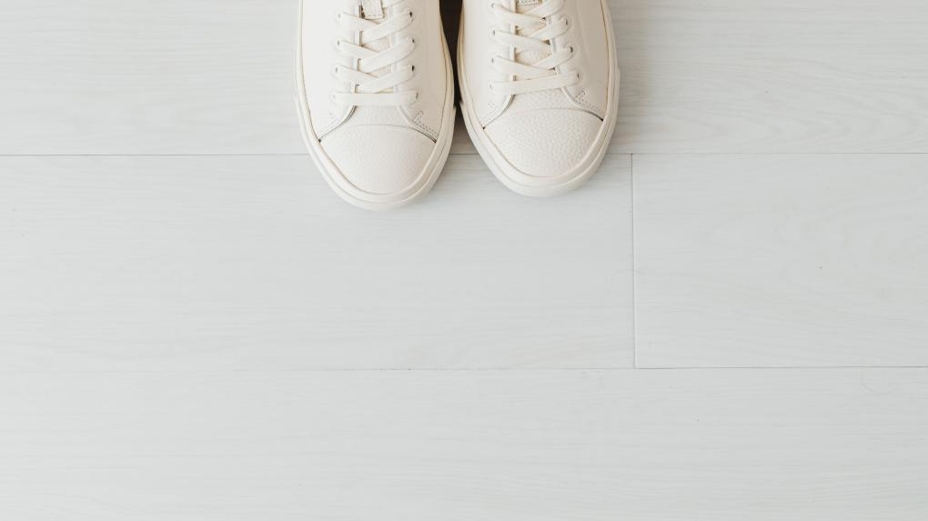

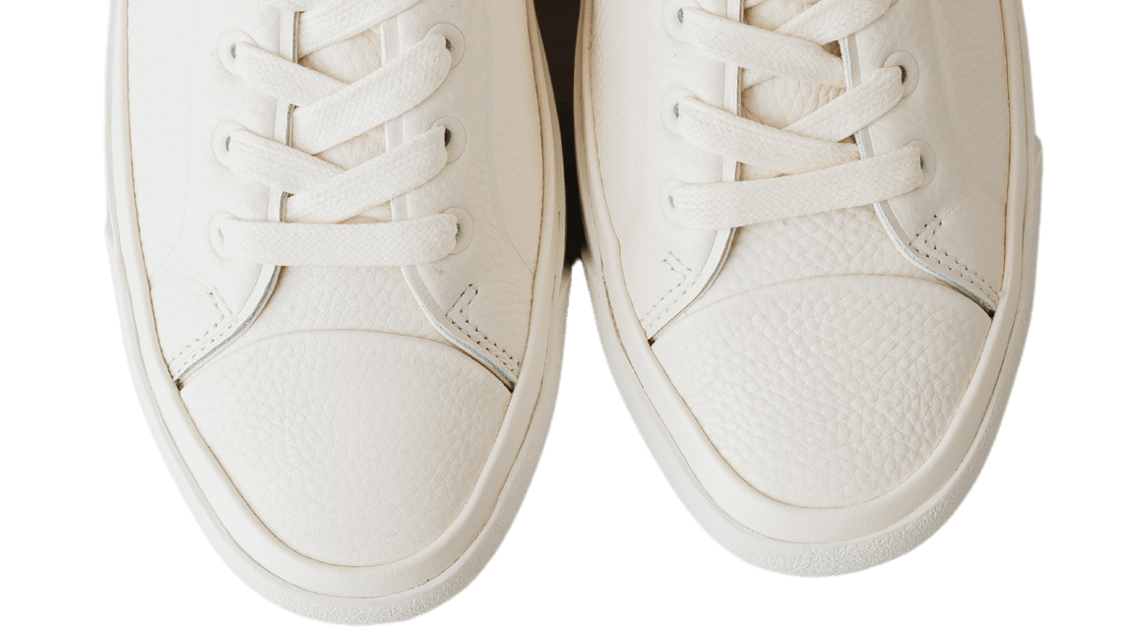
Tread With Style
January 2026
INTERNATIONAL SHOE STORE

Slide 2

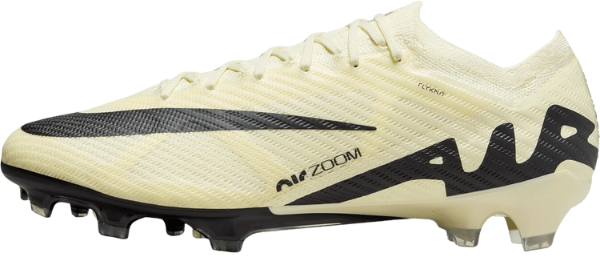
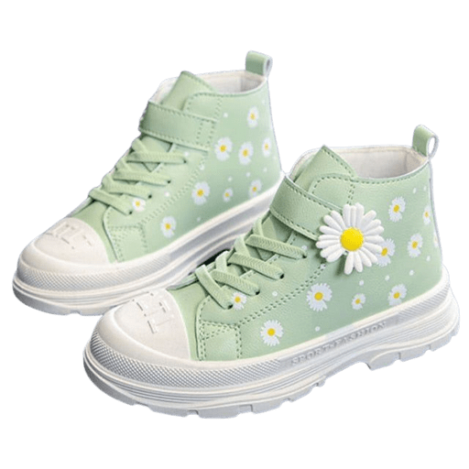
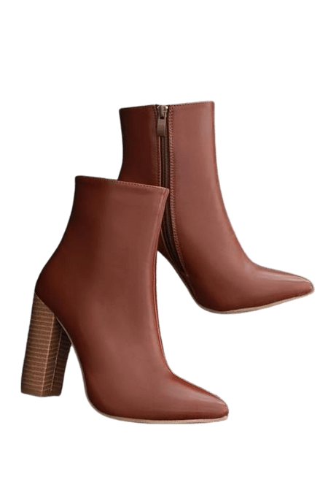
OBJECTIVES
This project provides a single online shoe store platform that brings all shoe categories together in one place, ensuring easy access, variety, and availability for everyone.

Slide 3
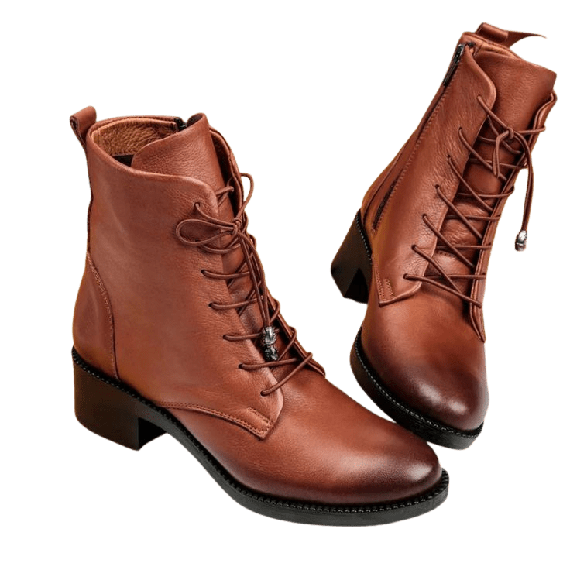

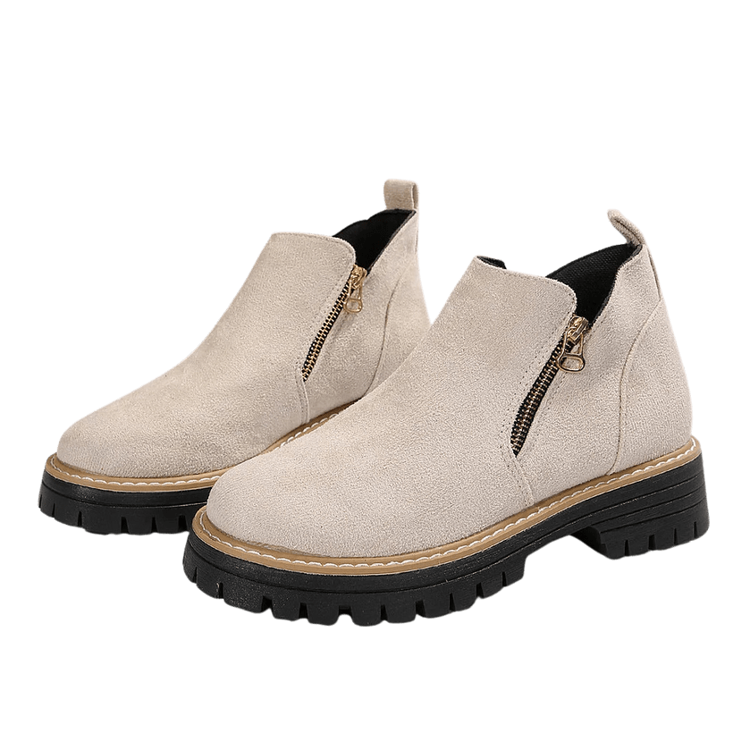
NEW ARRIVALS
Specials
Winter
Limited Ed

Slide 4
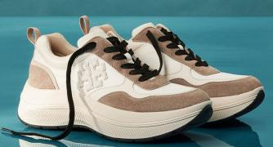
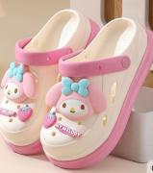
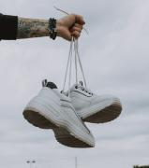
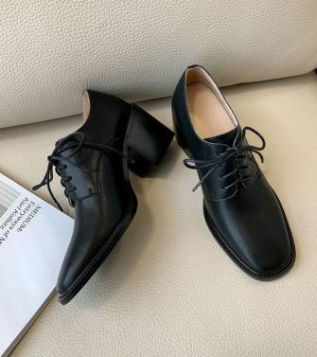
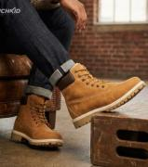
FEATURED CATAGORIES
MEN
WOMEN
Formal
Sneakers
Boats
Sports
Heels
Party Shoes
Sandals
Sneakers
KIDS
WEDDING
CLASS
School Shoes
Joggers
Crocs
ACCESSORIES
Bride
Bride Groom
School Shoes
Joggers
Crocs

Slide 5
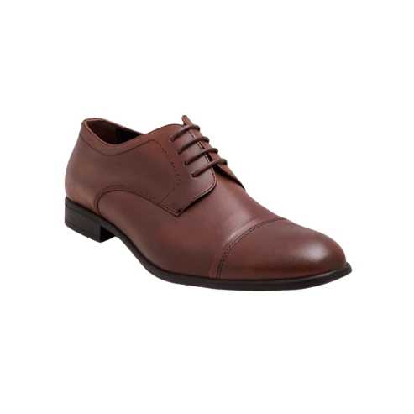
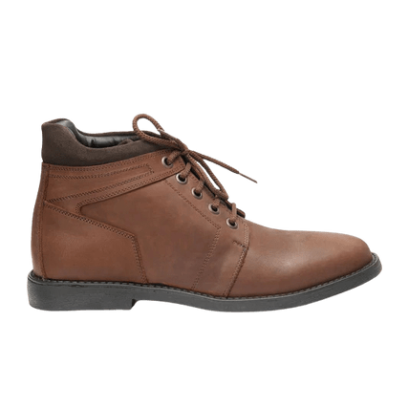
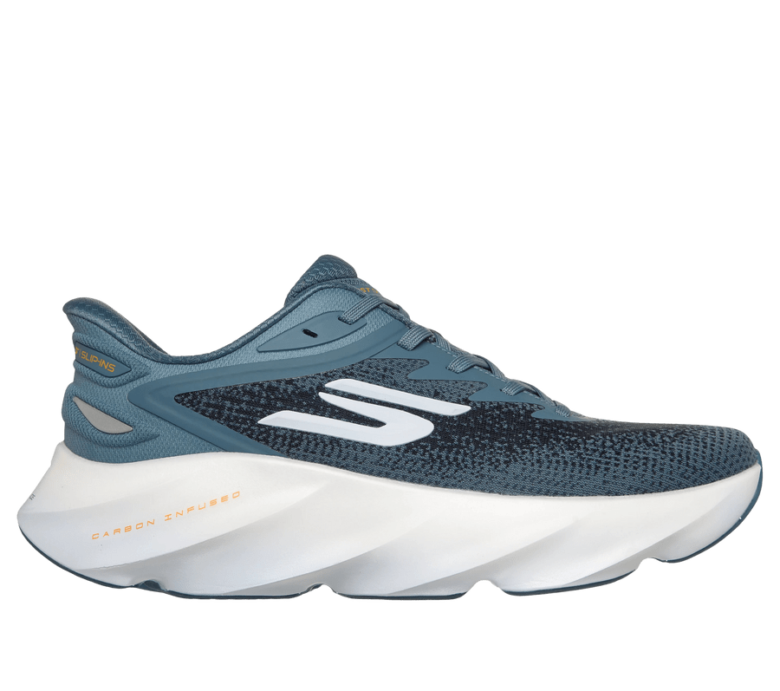
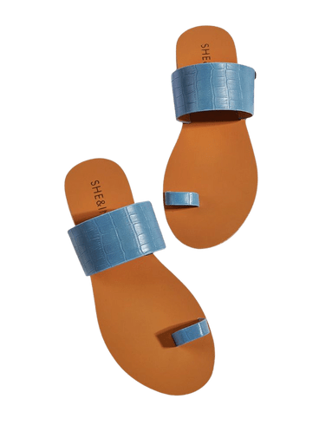
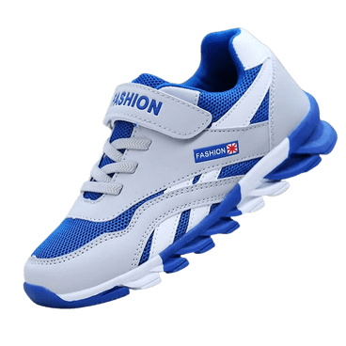
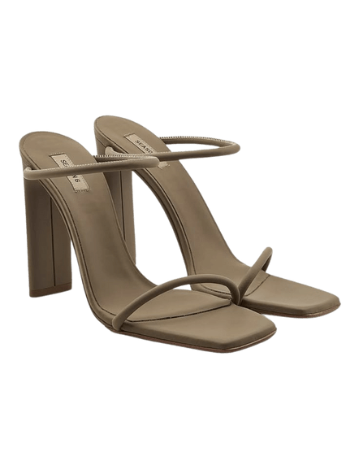
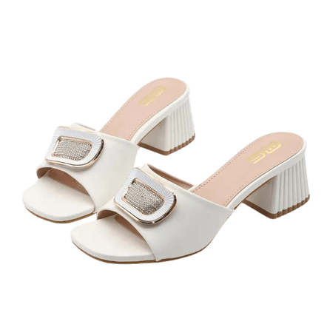
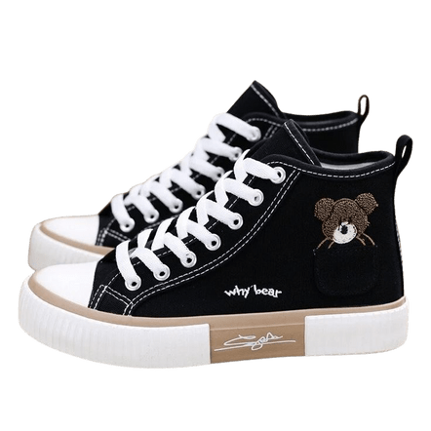
BEST SELLING PRODUCTS
Mostly a solid universal colour sneakers/Formals and everyday slippers including practicality and reliability.
Men
Comfortable soul sneaker
Tough and Classy boots and formals
Women
Elegant sneaker
casual slippers and practical heels
Kids
Everyday all going joggers

Slide 6
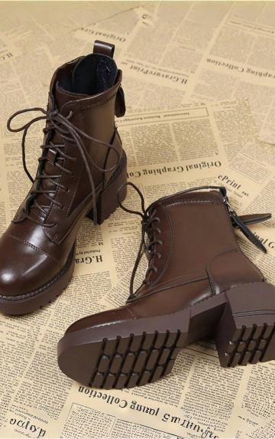
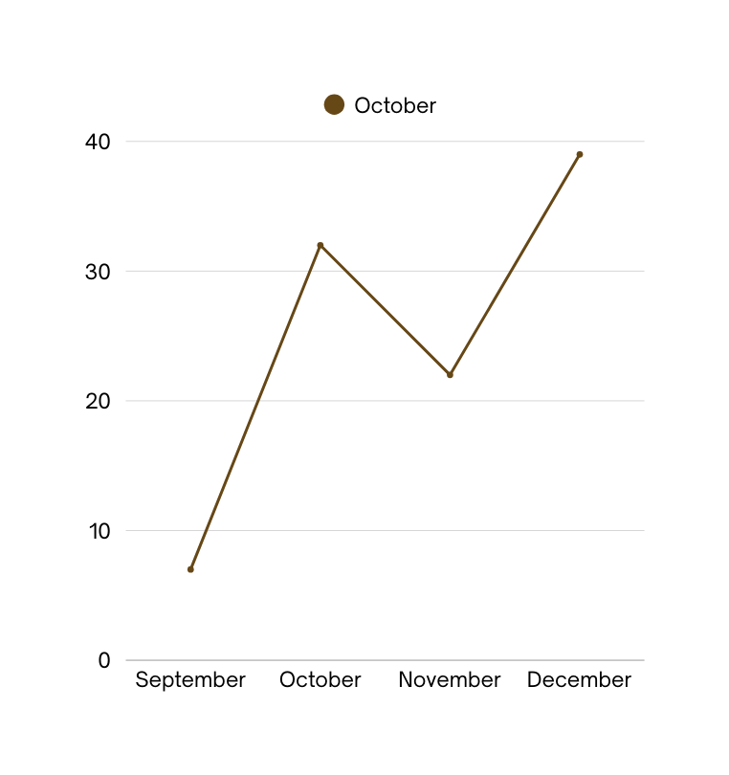
SALES PERFORMANCE
Overall sales have shown consistent growth driven by popular shoe categories and seasonal demand. In-store and online channels both contributed positively to revenue. Promotional offers and new arrivals played a key role in increasing customer purchases.
Here is a percentage graph growth rate

Slide 7
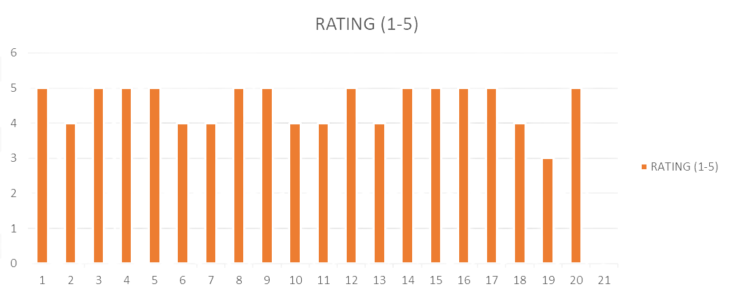
COSTUMER FEEDBACK
Overall Positive Feedback
showing costumer satisfaction

Slide 8
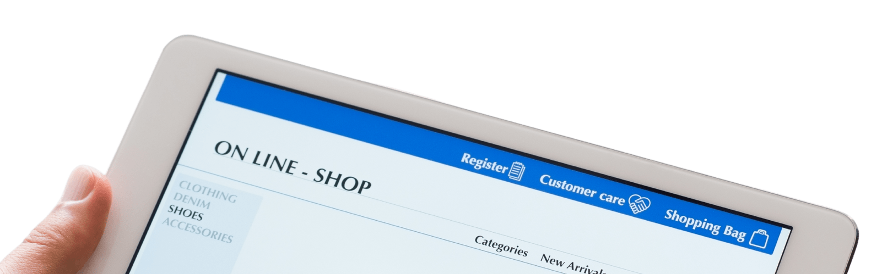

The website shows steady growth in online orders with peak sales during promotions and seasonal launches. User-friendly navigation have improved conversion rates. Traffic from mobile users is increasing, indicating strong customer engagement.
ONLINE SALES PERFORMANCE

Slide 9
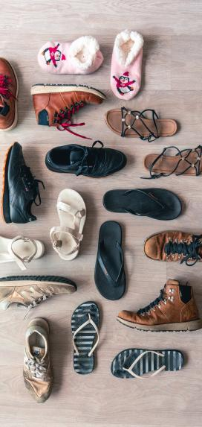
RETURNS AND
Return policy is valid all around the globe.
different Purchases the return time may vary.
Exchange policy is applicable on all products of a domin
We allow return and exchange within 7 days of delivery.
To ensure satisfaction of our costumers
EXCHANGES

Slide 10
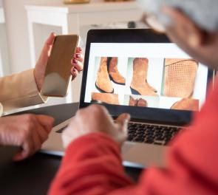
DESIGN
DECISSIONS
Colour Theme:
took inspiration from HushPuppies and liked the colour palate
Layout and Structure:
we kept improving the layout until we got it to be an effortless experience for the user
Font Style:
Font Poppins is used for professional appearance and readability

Slide 11
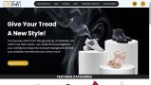

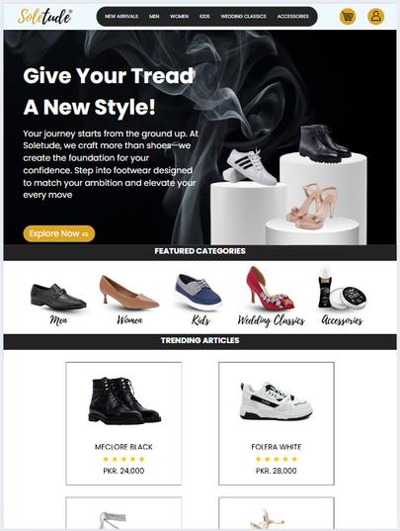
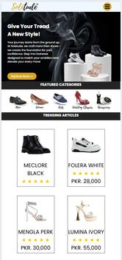
Responsiveness
The website is completely responsive. The units used for making the website responsive are
vh
vw
rem
em
vmax

Slide 12
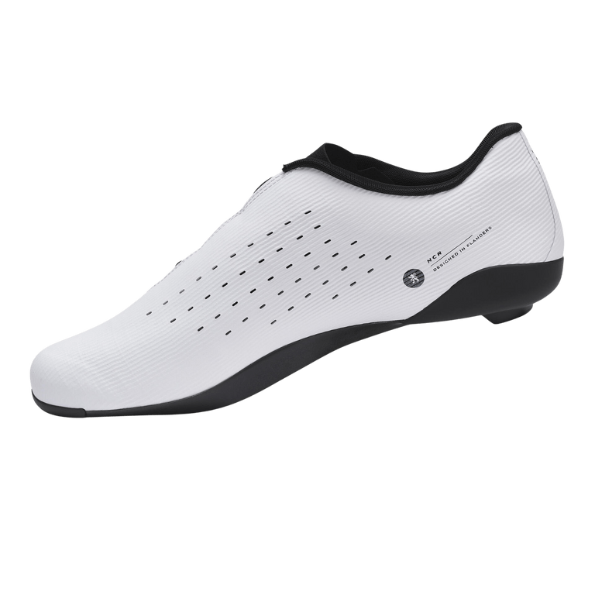
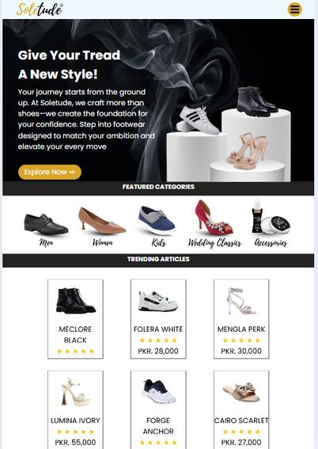
REFLECTION AND NEXT STEPS
Reflections:
The shoe store project helped us understand customer preferences, inventory management, and effective visual merchandising.
Next Steps:
Expand product variety, strengthen online presence, and introduce customer loyalty programs to boost sales and engagement.

Slide 13
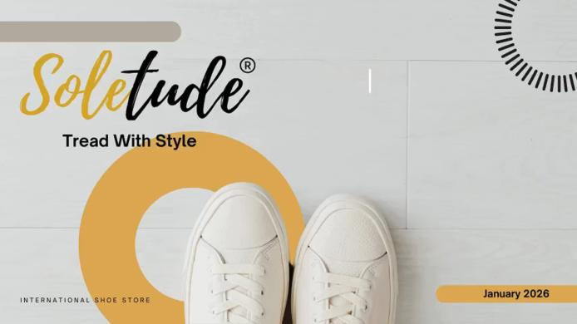
Live Demo of WebSite

Slide 14



GitHub & LinkedIn Links
GitHub
LinkedIn
GROUP REPOSITORY
Faizan Ahmad
https://github.com/dua123-maker/Group1-Business-Startup-Agency-Project
Abdullah Wasif
M Shoaib
Amama Ishaq
Duaa Javaid

Slide 15
THANK YOU
January 2025

